Slide 1
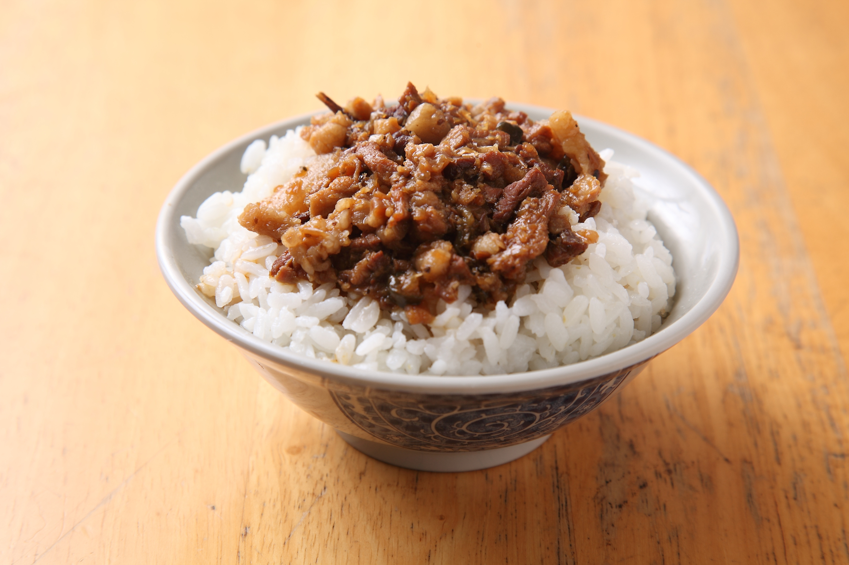
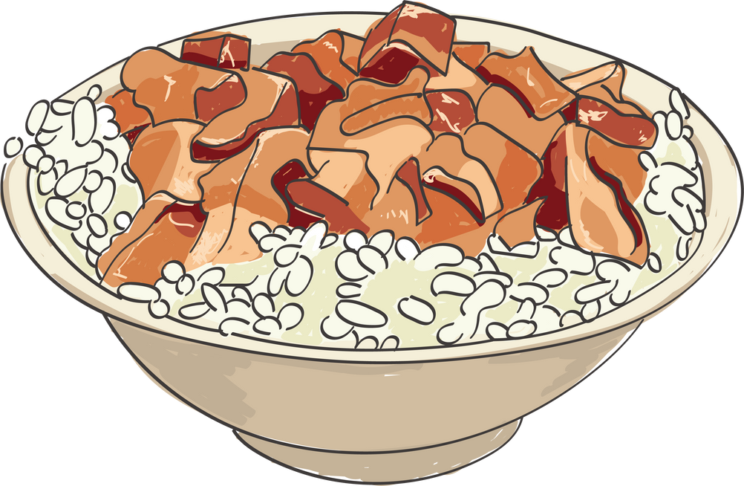

Braised
Pork
Rice
Presented by 714 Group 2

Slide 2
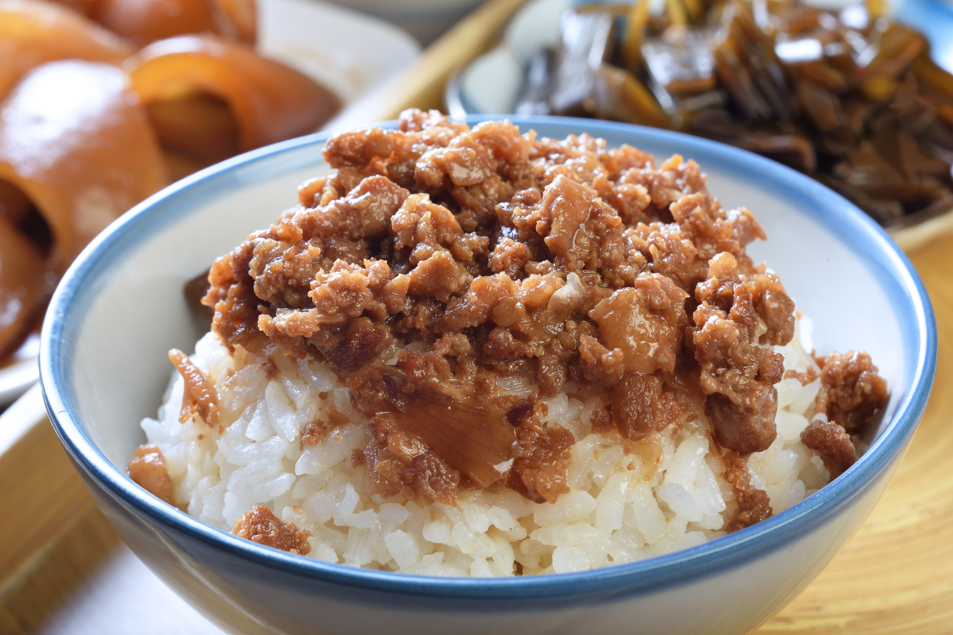
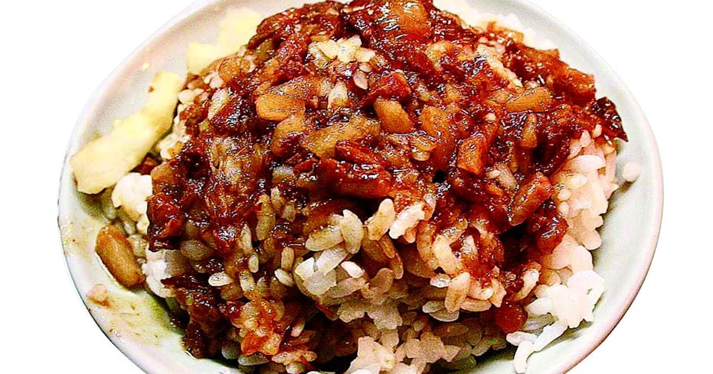
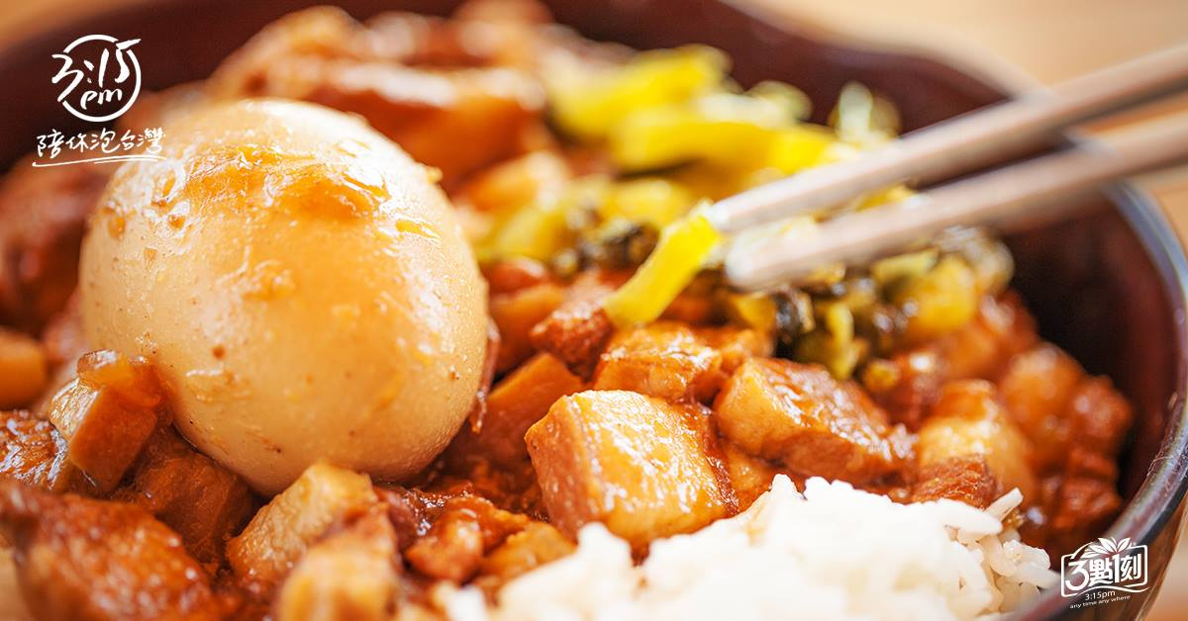

(1)Braised Pork Rice: Taste
Yummy
Salty
Fatty
2

Slide 3
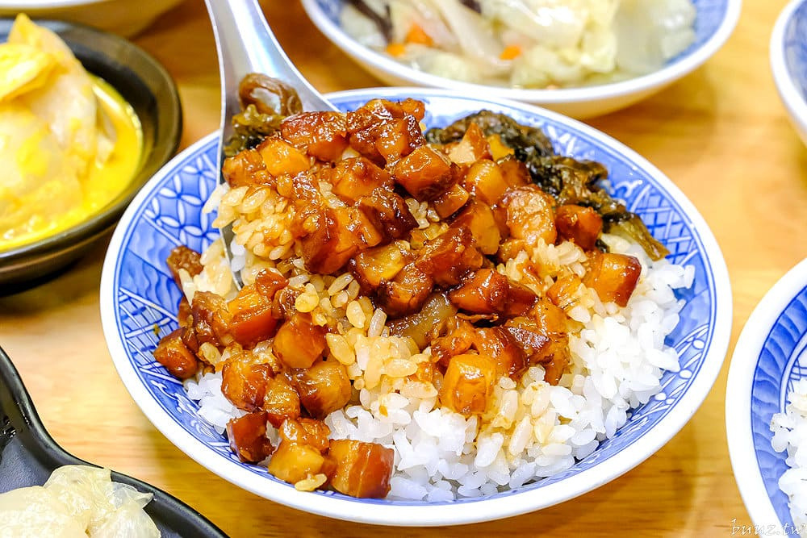
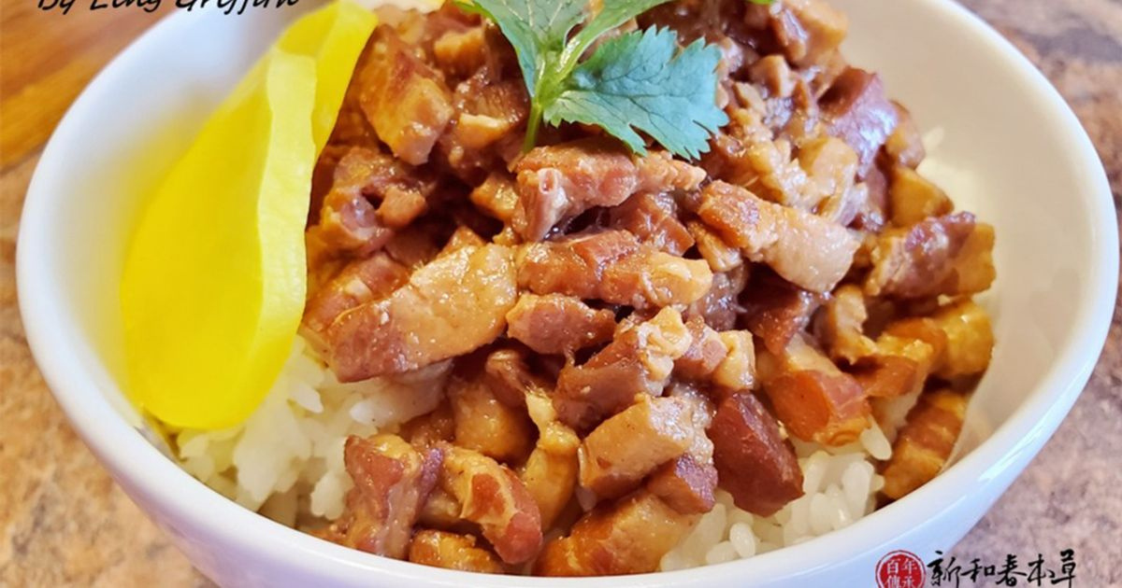
(2)Different from other food
small pieces of pork
meat is soft
The flavor is sweet

Slide 4
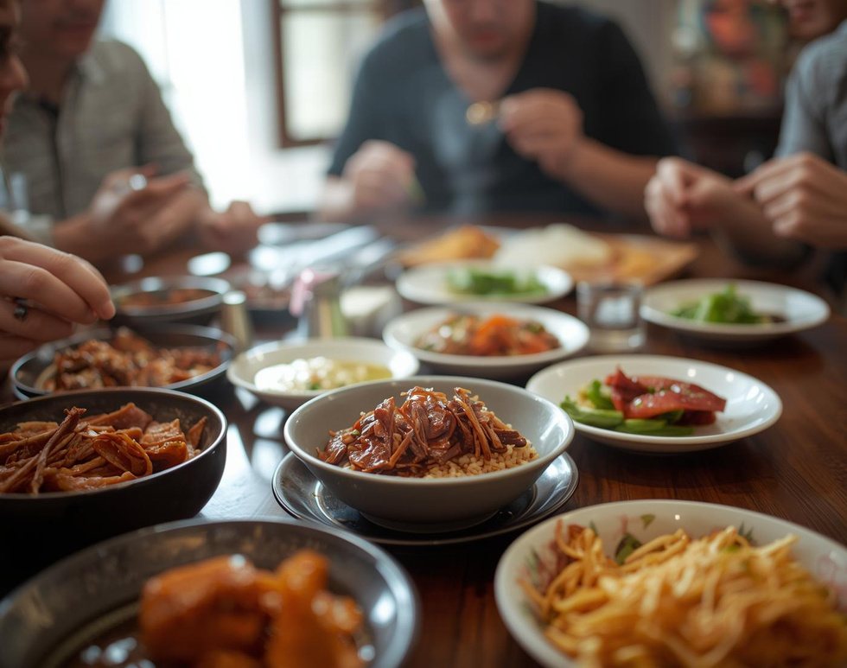
(3)Some interesting about
Braised Pork Rice
Even if you haven't eaten Braised Pork Rice, you must have smelled its aroma.

Slide 5

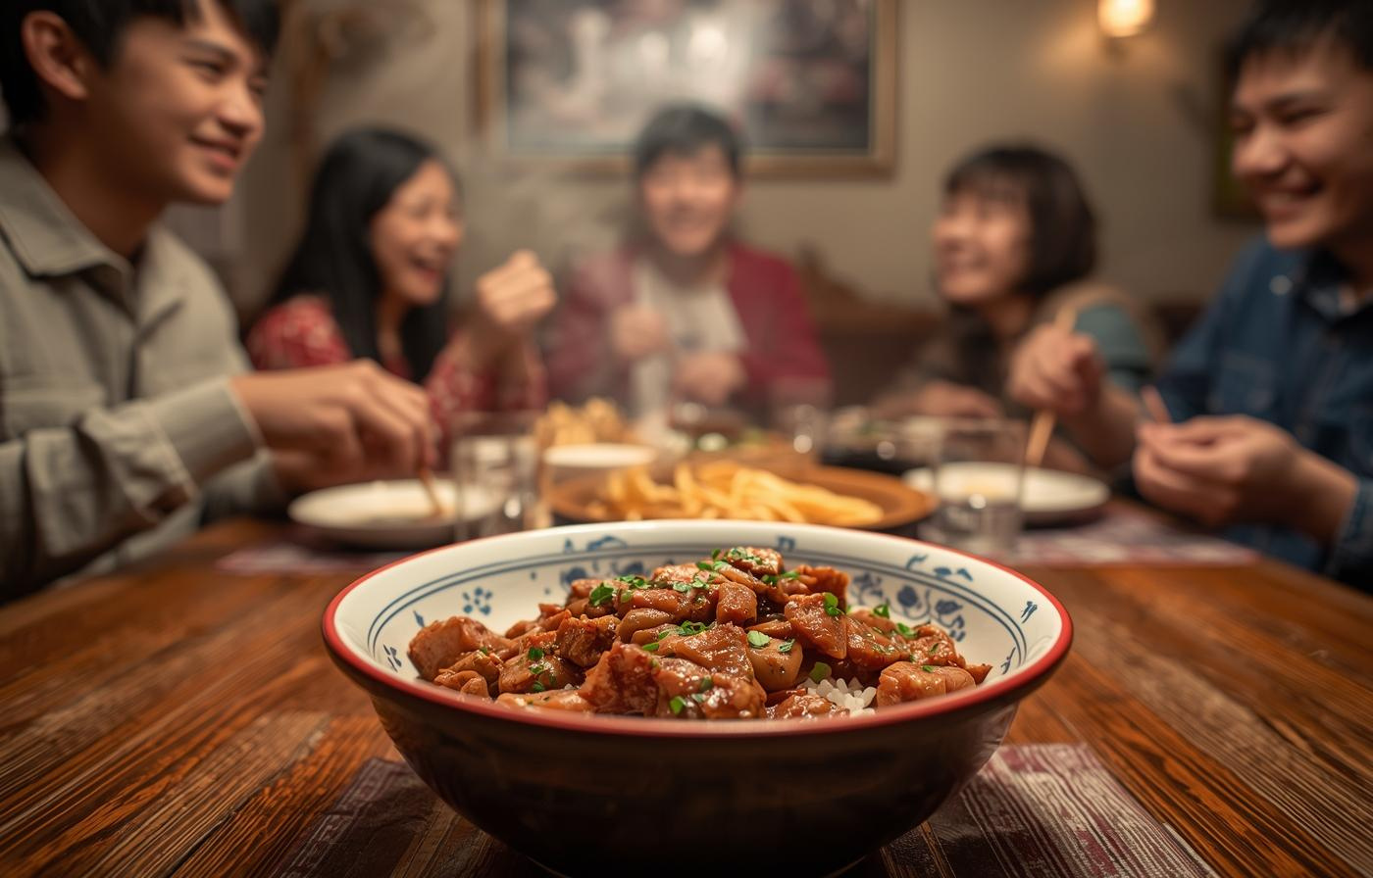
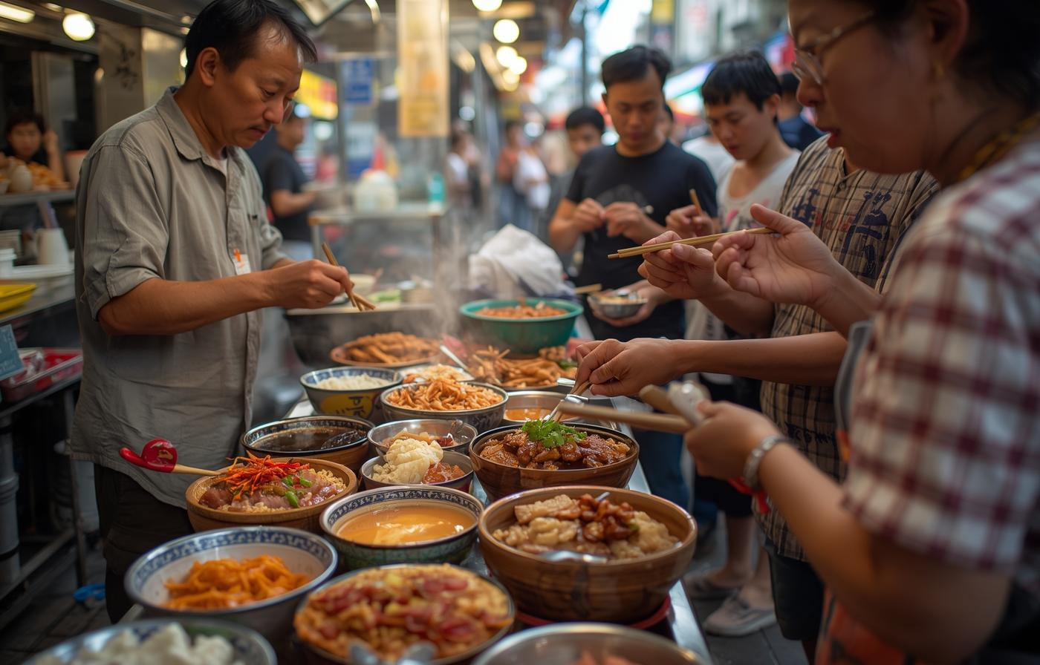
Why should we choose
Braised Pork Rice
in night market?

Slide 6
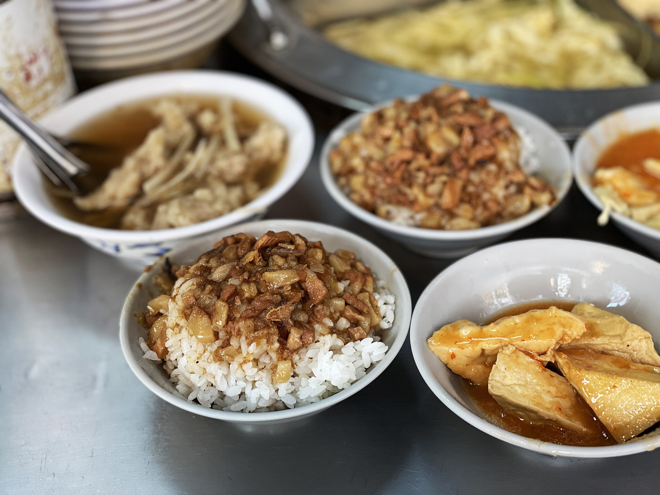
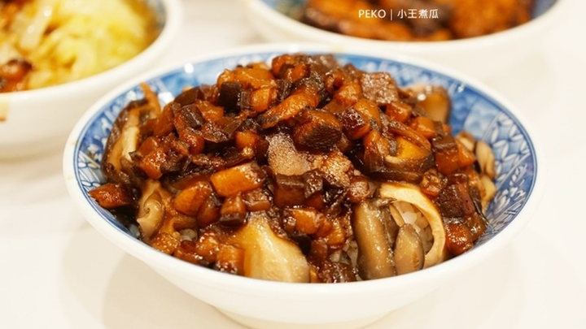
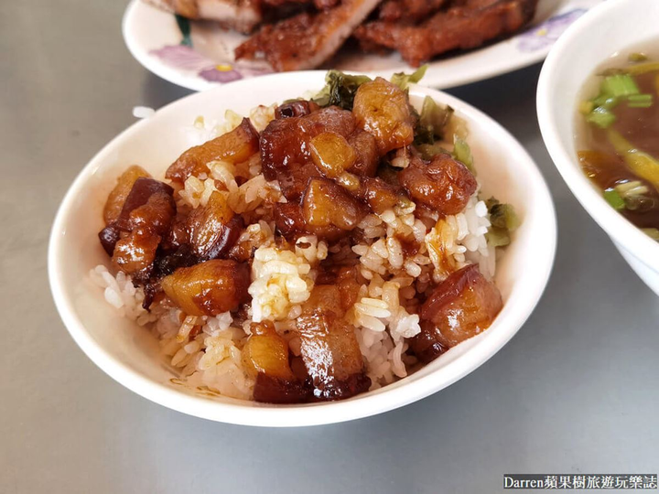
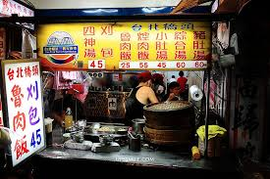
Highlight:
The Heart of Braised Pork
Rice
Smells Great
Cheap and YUMMY
Smells makes you drool.
Get delicious food for less than $50
The special feeling
The special feeling of the night market you have never seen.

Slide 7
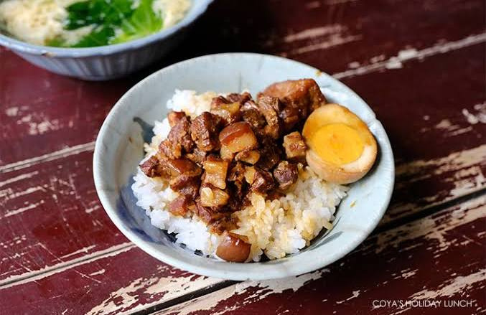

Enjoying
Braised Pork
Rice!
Thank’s for listening
Made By 714 Group 2

